Slide 1
Pruning Filters for Efficient CovNets
1) Comparison with weights Pruning
We prune filters from CNNs that are identified as having a small effect on the output accuracy.
Pros:
computation costs are reduced significantly
does not result in sparse connectivity patterns
Magnitude-based Pruning of weights reduces the number of parameters in the CNN.
Cons:
Don’t affect computation cost.
Increase irregularity in CNN
Solution
2) Why we need filter pruning ?
Applications that reside with less computation power in techs like embedded sensors or mobile devices. For them, computation cost and network size matter a lot.
High capacity networks have significant inference cost.
Applications such as web services provide image search often operate on the time budget.

Slide 2
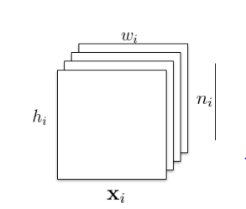
The number of pruned filters correlates directly with acceleration by reducing the number of matrix multiplications, which is easy to tune for a target speedup. In addition, instead of layer-wise iterative fine-tuning (retraining), we adopt a one-shot pruning and retraining strategy to save retraining time for pruning filters across multiple layers, which is critical for pruning very deep networks.
3) Understanding Filters in CNN
Lets assume we have a layer with each feature map as height hi and width wi
We have ni such feature maps
We will create a filter (K) which will have kernel size as k X k and the n_{i+1} dimensions.
For eg : input is an RGB image with hi = 64, wi= 64 and ni = 3
The filter we created is k = 4 and n_{i+1} = 128.
Therefore filter size is 4 X 4 X 128.
Now these individual 4 X 4 filters have different values in them.
And theses 128 filters each will apply on R, G and B

Slide 3
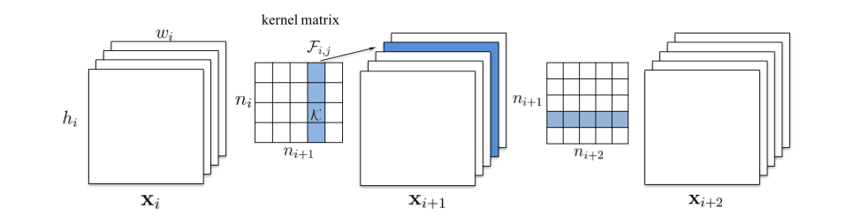
4) Understanding Pruning of Filters in CNN
For pruning of filters we make a matrix of filters with dimensions ni ( input dimensions ) and n _{i+1} and we select some filters among this matrix of filters to prune.
For Eg : in previous eg we had ni = 3 (RGB) and n_{i+1} = 128. So we might remove one filter among the 128 filters which will be applying on RGB layer of input image.
Now our dimensions become 127. It reduced calculation of that one filter which was going to multiplied by RGB.
Moreover, now since for next layer we have input dimesion of 127. Therefore if n_{(i+2)} is 256. Therefore it reduced the calculations for that one removed filter with next 256 filters.
Pruning m filters of layer i will reduce m/ni+1 of the computation cost for both layers i and i + 1

Slide 4
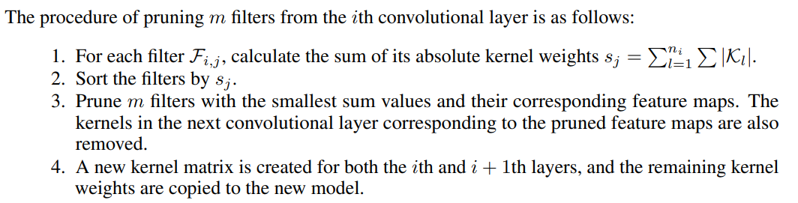
4) Understanding which filters to reduce ☹
5) Different ways of Pruning
Single Layer sensitivity to Pruning
Pruning Filters across Multiple layers

Slide 5
6) Single-layer Pruning
To understand the sensitivity of each layer, we prune each layer independently and evaluate the resulting pruned network’s accuracy on the validation set.
We empirically determine the number of filters to prune for each layer based on their sensitivity to pruning.
For deep networks such as VGG-16 or ResNets, we observe that layers in the same stage (with the same feature map size) have a similar sensitivity to pruning. To avoid introducing layer-wise meta-parameters, we use the same pruning ratio for all layers in the same stage. For layers that are sensitive to pruning, we prune a smaller percentage of these layers or completely skip pruning them.
7) Multi-layer Pruning
For deep networks, pruning and retraining on a layer-by-layer basis can be extremely time-consuming. However, understanding how to prune filters of multiple layers at once can be useful.
Pruning layers across the network gives a holistic view of the robustness of the network resulting in a smaller network.
For complex networks, a holistic approach may be necessary. For example, for the ResNet, pruning the identity feature maps or the second layer of each residual block results in additional pruning of other layers.

Slide 6
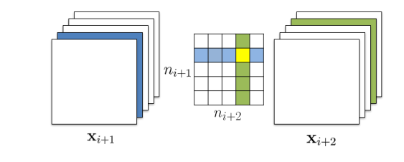
7.1) Multi-layer Pruning – strategies involved
Independent pruning determines which filters should be pruned at each layer independent of other layers.
Greedy pruning accounts for the filters that have been removed in the previous layers. This strategy does not consider the kernels for the previously pruned feature maps while calculating the sum of absolute weights.
The independent pruning strategy calculates the filter sum (columns marked in green) without considering feature maps removed in previous layer (shown in blue), so the kernel weights marked in yellow are still included. The greedy pruning strategy does not count kernels for the already pruned feature maps. Both approaches result in a (n_{i+1} − 1) × (n_{i+2} − 1) kernel matrix.

Slide 7
8) Retraining Pruned Network to regain accuracy
After pruning the filters, the performance degradation should be compensated by retraining the network.
Prune once and retrain: Prune filters of multiple layers at once and retrain them until the original accuracy is restored.
Prune and retrain iteratively: Prune filters layer by layer or filter by filter and then retrain iteratively. The model is retrained before pruning the next layer for the weights to adapt to the changes from the pruning process.

